Slide 1
Peaches, Snakes, and Double Meanings: Applying Embeddings to Emojipastas
Aidan Casey and Simon Mason

Slide 2
Intro: The Problem
Online communication often includes emojis, which are not part of most word embeddings such as word2vec
Emojis often have double-meanings or shifting meaning
Enter Emojipastas as seen on r/Emojipasta
Long form posts with a phrase-emoji pattern
Built mostly for humorous effect, and often includes the double-meanings emojis might contain
The Goals:
Can we capture some of these aspects by training embeddings on this dataset?
Can this improve performance of a down stream task?

Slide 3
Method: Training Embeddings
CBOW
As seen in word2vec
Also as seen with emoji2vec, a work that created embeddings based on the official Unicode description of the emoji
Split data into sets of 5: target word in the middle, 4 context words on each side
Train a classifier based on the mean of the 4 context words
Use GloVe for normal English words (frozen), then start with randomized or emoji2vec embeddings for emoji and train

Slide 4
Method: Testing
Visualization and Cosine Distance
Universal Manifold Approximation (UMAP)
N-gram
Dataset seems related (phrase-emoji pattern)
Drawbacks: not an easy task
Benefits: no annotation required!

Slide 5
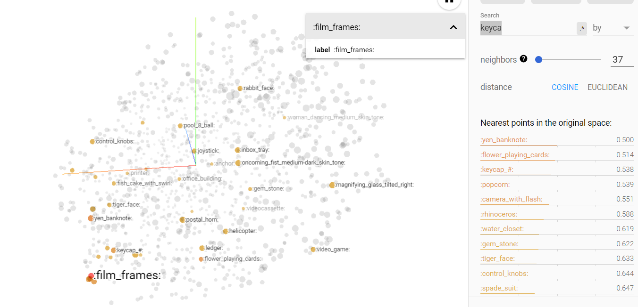
Experiments and Results: UMAP
Cluster of Movie Related Emojis in CBOW trained emoji2vec
:film_frames:, :popcorn:, :camera_with_flash: are reasonably close
Also, a keycap cluster in CBOW from randomized

Slide 6
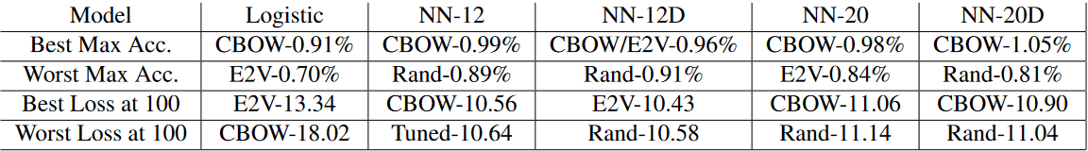
Experiments and Results: N-gram
CBOW (from randomized) almost always did best
Random usually did poorly
Low accuracy and high loss, but N-gram is a very tricky task and we trained on very limited data

Slide 7
Discussion
Limited data (only so much data in one subreddit)
Emojis can have a lot of uses and most datasets are inconsistent at best (no Wikipedia filled with emoji usage)
Emoji’s can have many meanings based on context, perhaps in the future work with adapting technologies like ELMo to emojis will perform better
Thoughts on the future:
New Data sources
New types of models for embedding and testing
Generative model in far future

